Slide 1
Scottish Radiology Transformation Programme
Supporting the delivery of a world class, person-centred sustainable radiology service that continually improves the health and wellbeing of the people of Scotland.
Dr Hamish McRitchie

Slide 2
The Case for Change
Current Radiology Services are Unsustainable
Insufficient capacity to meet demand
Demand is increasing – 3.4% per year = £1.2m per year.
Waiting times are increasing – 70% increase in patients waiting over six weeks (rise from 6,700 in Dec 2018, to 11,300 in Dec 2019).
Costs are increasing – Reporting outsourcing costs of £11.6m, net cost 2015/16 = £221m, 2019/20 = £244m.
Risk that radiology services will fail…
…impacting patient diagnosis and treatment in acute and primary care.

Slide 3
The Case for Change
Increasing complexity of activity:
In the past five years:
54% increase in demand for (CT)
48% increase in (MR) exams
8% increase in other modalities
Reducing demand:
Clinical decision support
Increasing:
Population growth
Exam request growth
Artificial Intelligence:
Image analysis
Natural Language Processing
Niche products
General solutions
Reporting Activity
2018
£11.6 million gap
Outsourcing £5,069,000
Insourcing £4,785,000
Ad-hoc locums £1,740,000
2015
£5.25 million gap
Reporting Capacity
Currently declining:
Retiring Radiologists
Tax/pension disincentives
Increasing vacancies
Radiographer supply inadequate
More trainees LTFT
2016
2019
2023
10 YEARS
Increasing Capacity:
Workforce Solutions
10 trainees entering market annually from 2024
National Bank
Advanced Practice
Clinical Decision Support

Slide 4
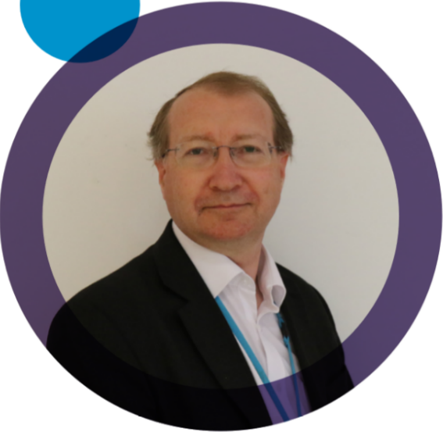
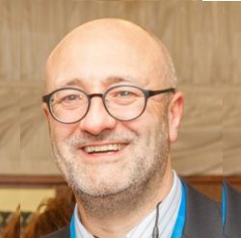
Our Team: Clinical
Dr Hamish McRitchie SRTP Medical Director
Dr Shalini Datta
Clinical Lead SNRRS
Dr Raj Burgul
Clinical Lead National Data CDS
Dr Mark Hall
Clinical Lead Artificial Intelligence
Dr Simon McGurk
Steering Group Chair Advancing Practice
Jonathan McConnell
Clinical Lead Vision & TOM Advancing Practice
Clinton Heseltine
Clinical Lead Workforce Planning

Slide 5
Governance
NHS Chief Executive Group
Diagnostics in Scotland Strategic Group
Regional Group North
Corporate Finance Network
Imaging Executive Board
Regional Group East
Regional Group West
IEB Clinical Reference Group
Scottish Radiology Transformation Programme (SRTP)
Scottish Clinical Imaging Network (SCIN)
PACS Reprovisioning Programme Board
National PACS Governance Board

Slide 6
Overarching Vision and TOM
3. Target Operating Model
What could the service to deliver the vision look like?
1. Vision
What kind of service do we aspire to?
4. Roadmap
What are the steps to bridge the gap between today and the future?
2. Current Operating Model
What does the service look like today?

Slide 7
Radiology Vision and Principles
1. Examinations that add value to the patient journey with no detriment. (Realistic Radiology)
2. Equitable access to imaging services including expert opinion available regardless of patient location.
3. Image acquisition as close to home as practically possible.
10. Investment in our people to ensure they have the skills to deliver the needs of the service.
A world class, person-centred sustainable radiology service that continually improves the health and wellbeing of the people of Scotland
4. Timely access to
investigations and their results.
9. A great place to work where the team is valued, motivated and multi-disciplinary.
5. Information to patients to make sure they are clear about their journey, options and results.
8. An innovative service that continually strives to improve, and benefits from emerging technologies and learning from similar services across the world.
7. A locally delivered service, informed by local needs, supported by regional and national coordination and collaboration where this adds value, resilience and sustainability.
6. Patient-centred services using fully integrated data and technology to deliver the right test at the right time.

Slide 8
TOM Roadmap
The roadmap mirrors the following key areas:
Workforce, demand and culture
Digital technology
Organisation of radiology services
Business information and data
Education and training
Processes.
The roadmap defines how the service gets from the current to the future state. Against each collective recommendation, the following information is set out:
A description of the key initiative(s) that will deliver the collective recommendation
Enabling Partner(s) who will support the delivery of the initiatives
Approximate timescales for delivery.

Slide 9
Transforming Radiology Services
The Programme is looking at areas spanning workforce, technology & innovation and service models.
Phase One laid the foundations to support the delivery of the vision for Radiology in Scotland.
Phase Two is building on this.
Phase 1 (2016-2019)
IT Connectivity
National Data
Workforce pilots
Beyond Phase 2
Business as usual
Transformation projects
Continuous improvement
Phase 2 (2020-2023)
Vision & Target Operating Model
National Reporting Bank
Advancing Practice
Clinical Decision Support
Artificial Intelligence
Workforce Planning

Slide 10
Artificial Intelligence
Dr Mark Hall - Clinical Lead

Slide 11
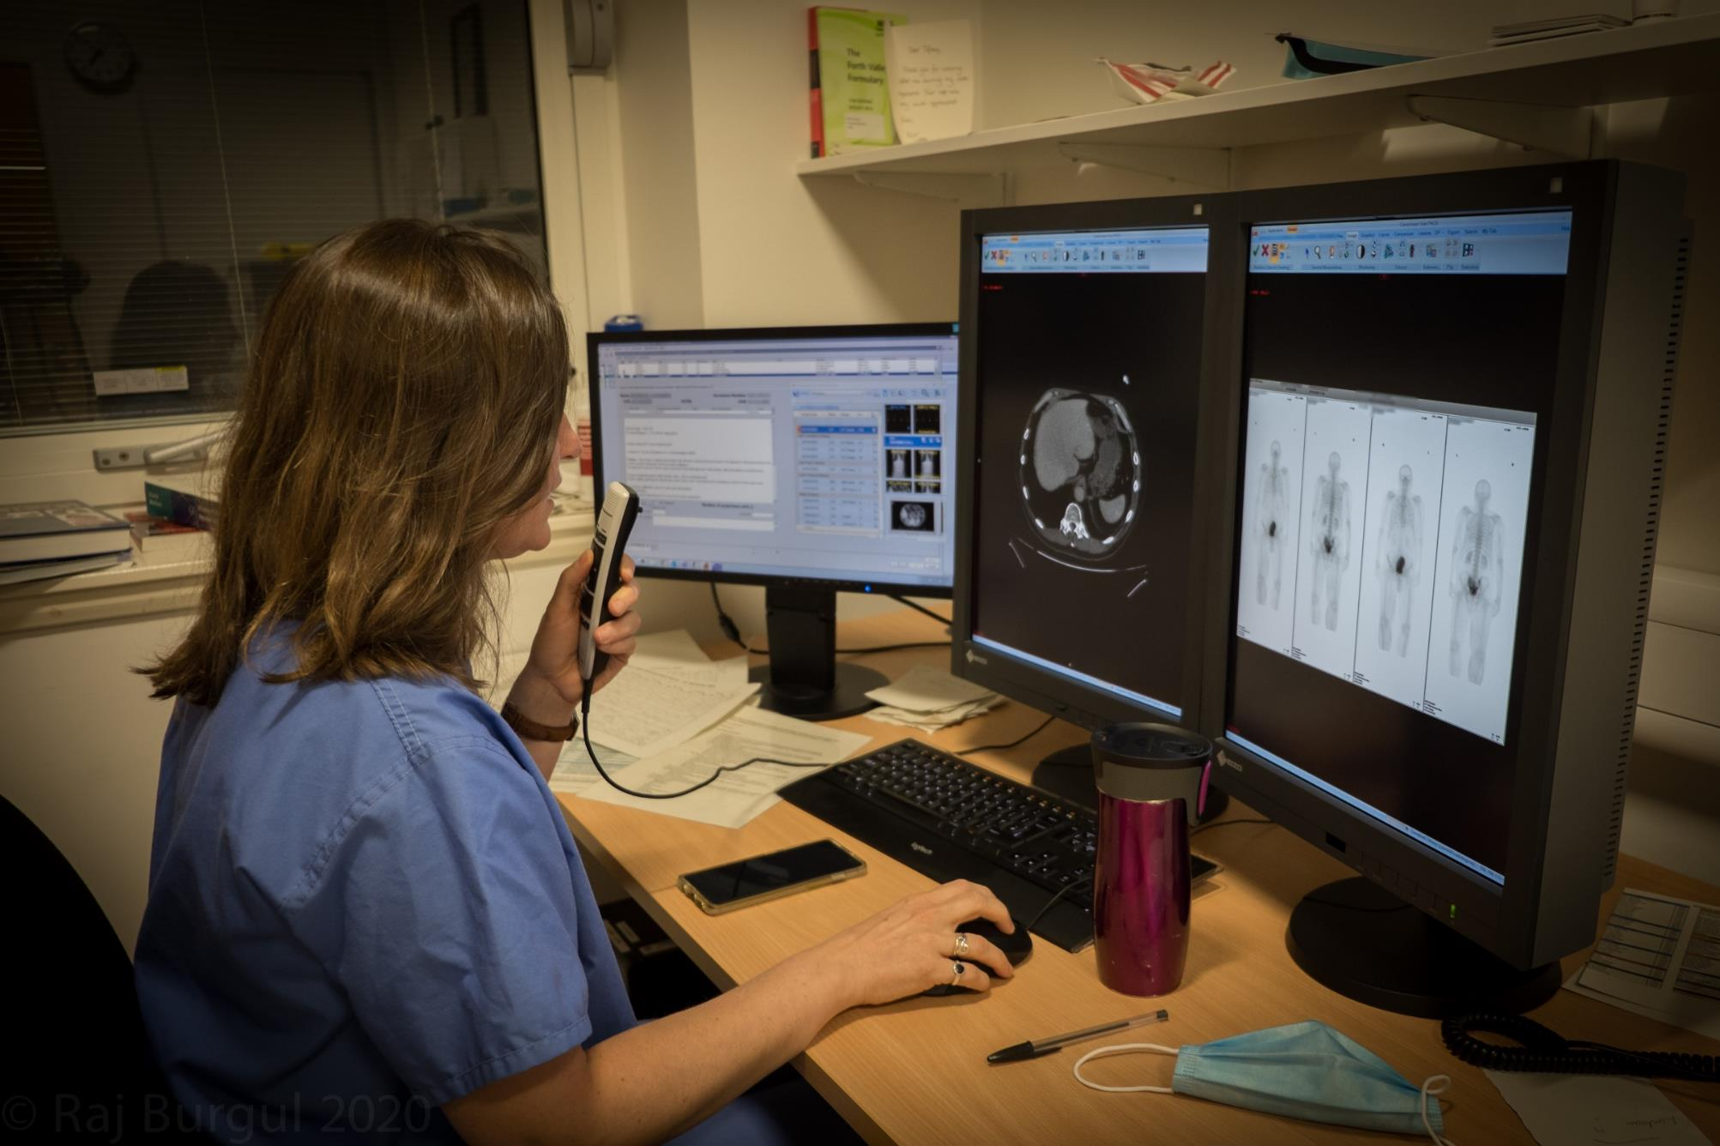
Scottish National Radiology Reporting Service (SNRRS)
Dr Shalini Datta - Clinical Lead

Slide 12
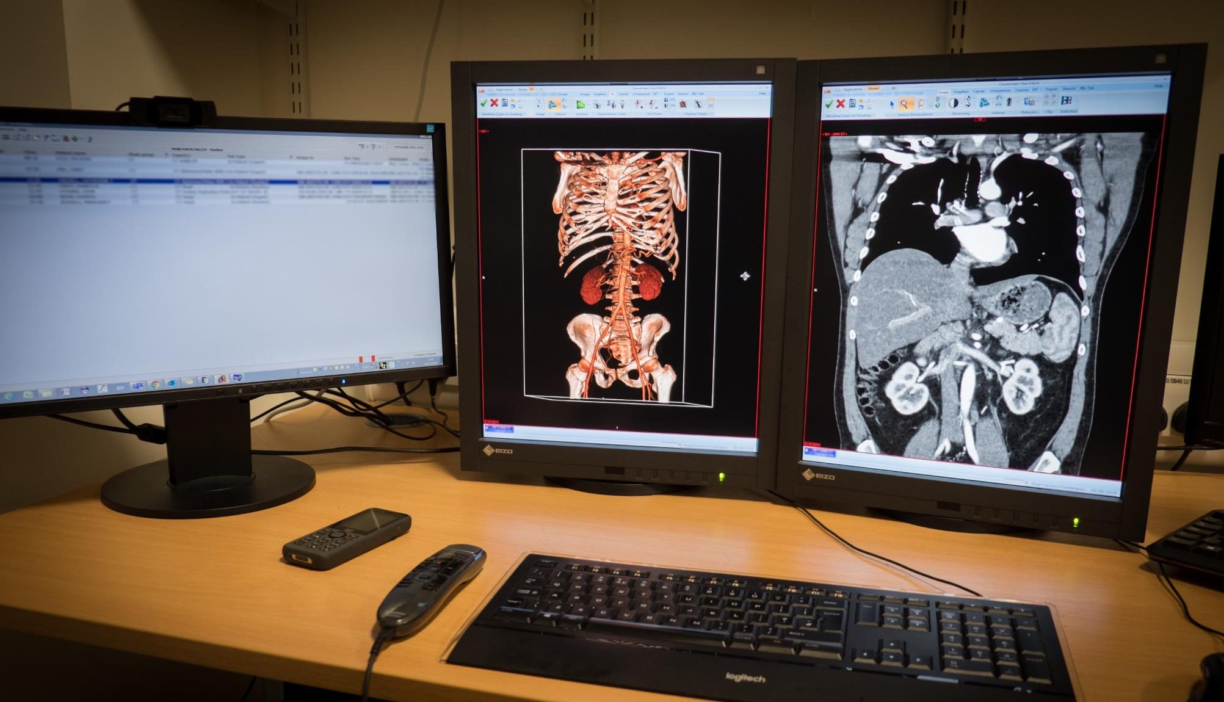
Advancing Practice
Dr Simon McGurk - Clinical Lead

Slide 13
Advancing Practice Goals
Train and use advanced practitioners to support systems and improve “patient journey”
Allow career progression in radiography
Address capacity issues
Achieve a nationally agreed approach to implementing Advancing Practice
Target training to the needs of the patient
Ensure value for money.

Slide 14
Advancing Practice Training 2021/22
2021 - 19 confirmed training places following quality and value assurance by the project:
2022 - In the process of identifying training needs with the Boards via surveys and planned focus groups.
Two Chest X-ray trainee reporting radiographers (Tayside and Shetland) will be mentored via the SNRRS pilot in the first year.
Course | Course provider | Number of candidates | Board coverage
Assistant Practitioners | Robert Gordon University | 11 | Forth Valley (1), Greater Glasgow & Clyde (6), Highland (2), Tayside (1), Golden Jubilee (1)
CXR Reporting | University of Salford | 4 | Ayrshire & Arran (1), Highland (1), Shetland (1), Tayside (1)
GI Studies & Reporting | University of Salford | 2 | Ayrshire & Arran (2)
MSK Reporting | Glasgow Caledonian University | 2 | Grampian (1), Shetland (1)

Slide 15
Advancing Practice Training Next Steps
This is year three of Scottish Government three year funding commitment to train an additional 30 reporting radiographers by 2023
Year One: Nine reporting radiographers started training.
Year Two: Eight reporting radiographers started training plus 11 assistant practitioners.
Year Three: 13 reporting radiographers to be trained to meet full commitment
Distribution of these still open to discussion
Given national backlogs, may be diverted to Ultrasound training.
Planning required to identify training needs and suitable candidates for 2022/23 courses.

Slide 16
Advancing Practice: Radiologist Input
There are a wide range of aspirations of advanced practice for radiographers.
It is important to have both radiographer and radiologist engagement.
Much of the work so far is good but needs support.
Important to have enough radiologist voice to make the right decisions.

Slide 17
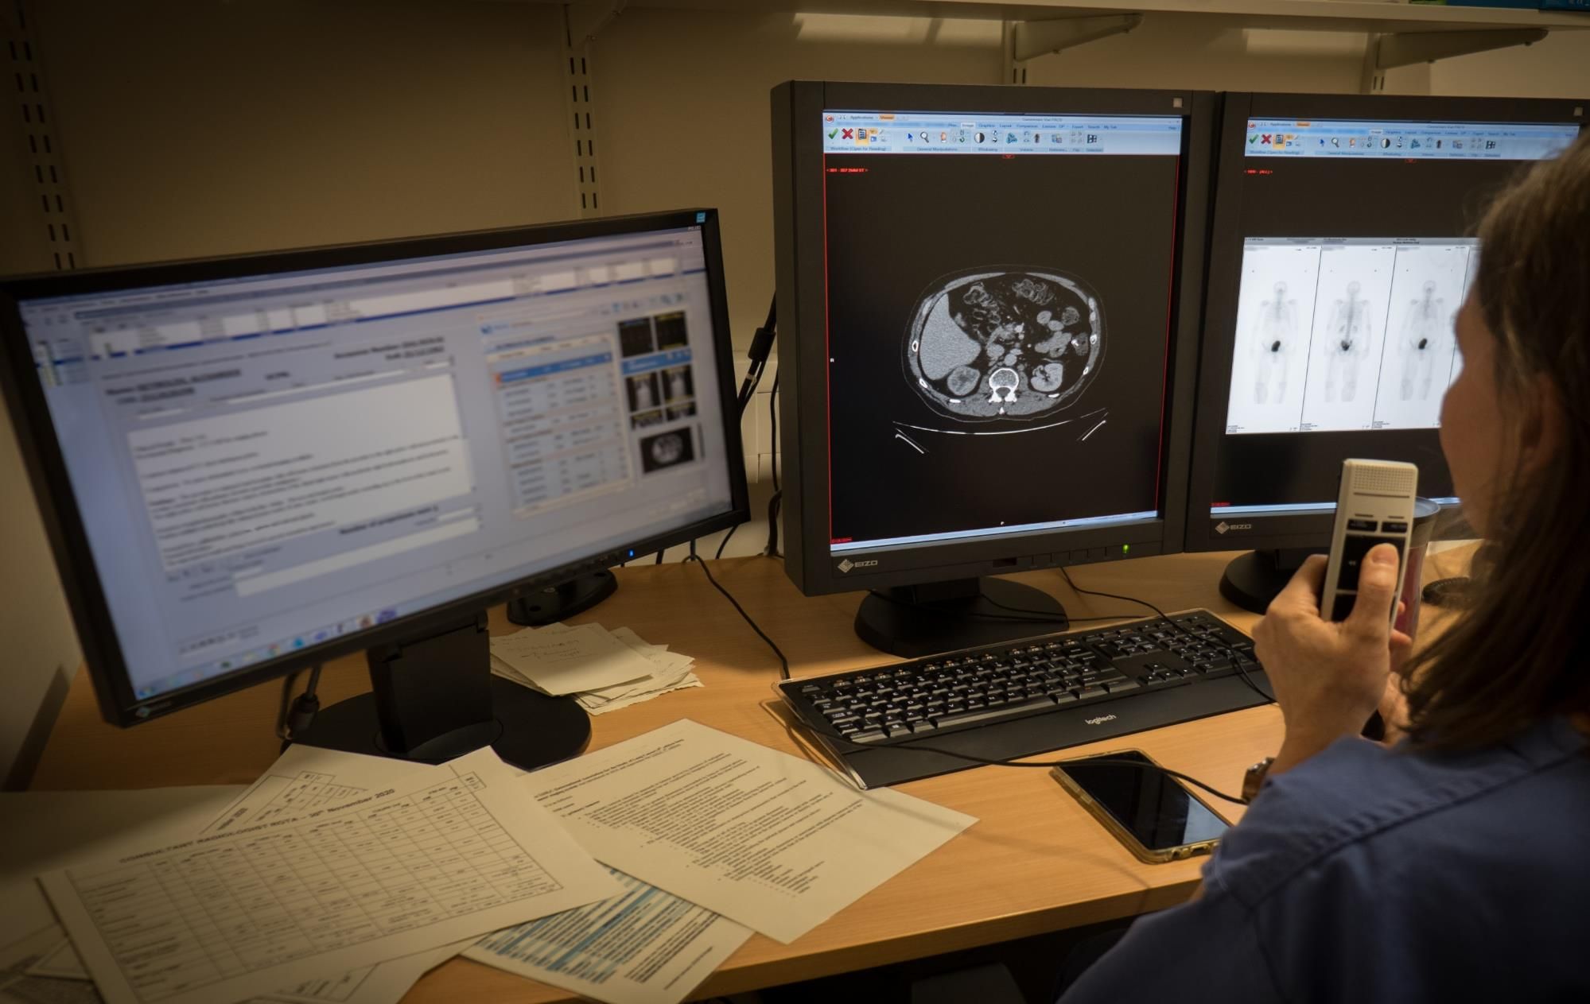
National Data and NRIIP
Dr Raj Burgul - Clinical Lead

Slide 18
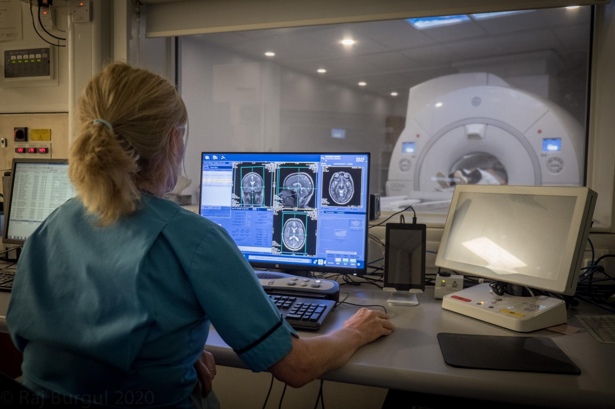
Workforce Planning
Dr Hamish McRitchie

Slide 19
Workforce Planning
Deliver a national workforce plan for the radiology service in Scotland by April 2022
Based on data and professional judgement
Using the recognised Six Steps approach service model > demand and supply > gap analysis > implement solutions >>
High-level first iteration of a multi-disciplinary holistic view of service workforce, on a national scale
Building on the recommendations within the recent Radiology Service Target Operating Model
Close collaboration essential.

Slide 20
Workforce Planning
Workforce Scope
Clinical Radiologists and Interventional Radiologists
Healthcare Support Workers
Assistant Practitioners
Diagnostic Radiographers
Advanced Practitioner Radiographers
Sonographers (non-obstetric)
Planned Steps
Map current state of radiology workforce and supply
Project future demand from data and scenario modelling
Identify required workforce to meet that demand
Solutions/ ideas to fill gap
Remote & Rural recruitment and retention recommendations.

Slide 21
Any Questions?
www.radiology.scot.nhs.uk/
Email: NSS.S.R.T.P@NHS.SCOT

